Slide 1
Name : Shraddh MADHAV WAGH
SUB : JAVA

Slide 2
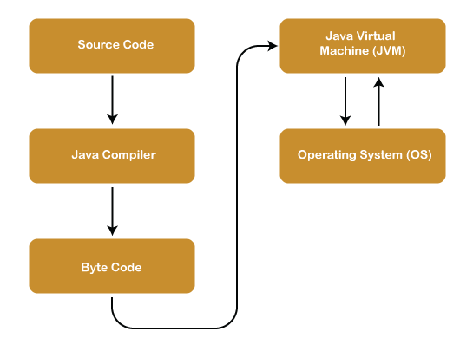
JAVA Architecture :

Slide 3
JAVA Architecture :
Java Architecture is a collection of components, i.e., JVM, JRE, and JDK. It integrates the process of interpretation and compilation. It defines all the processes involved in creating a Java program. Java Architecture explains each and every step of how a program is compiled and executed.
Java Architecture working :
There is a process of compilation and interpretation in Java.
Java compiler converts the Java code into byte code.
After that, the JVM converts the byte code into machine code.
The machine code is then executed by the machine.

Slide 4
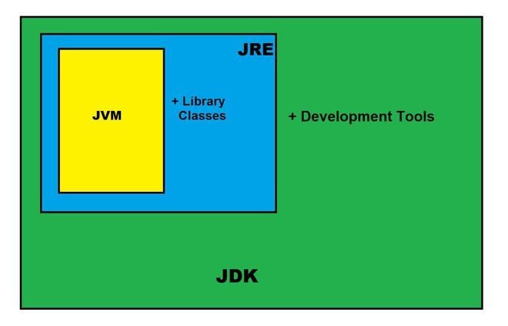
JDK Architecture :

Slide 5
JDK :
Java Development Kit :
The Java Development Kit (JDK) is a swoftare development environment used to develop Java applications and applets. It contains JRE and several development tools, an interpreter/loader (java), a compiler (javac), an archiver (jar), a documentation generator (javadoc) accompanied with another tool.
JDK contains:
Java Runtime Environment (JRE),
An interpreter/loader (Java),
A compiler (javac),
An archiver (jar) and many more.

Slide 6
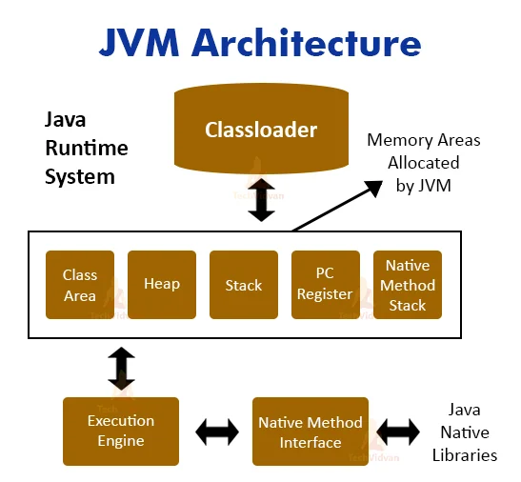
JVM Architecture :

Slide 7
JVM Architecture :
JVM(Java Virtual Machine) acts as a run-time engine to run Java applications. JVM is the one that actually calls the main method present in a java code. JVM is a part of JRE(Java Runtime Environment).
Java applications are called WORA (Write Once Run Anywhere). This means a programmer can develop Java code on one system and can expect it to run on any other Java-enabled system without any adjustment. This is all possible because of JVM.
When we compile a .java file, .class files(contains byte-code) with the same class names present in .java file are generated by the Java compiler. This .class file goes into various steps when we run it. These steps together describe the whole JVM.

Slide 8
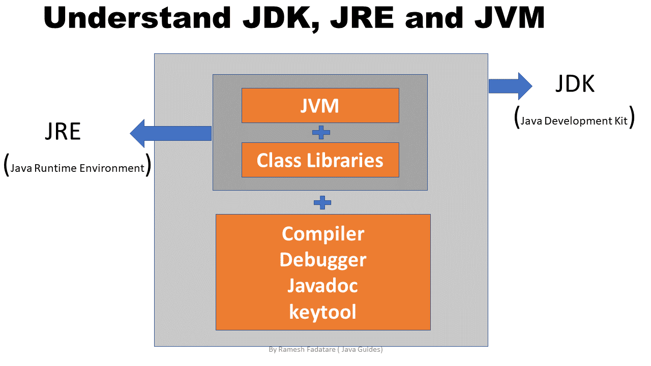
JRE :
Java Runtime Environment :
It provides an environment in which Java programs are executed. JRE takes our Java code, integrates it with the required libraries, and then starts the JVM to execute it. To learn more about the Java Runtime Environment.

Slide 9
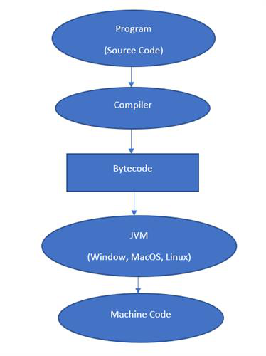
Bytecode:
Byte Code :
Byte Code can be defined as an intermediate code generated by the compiler after the compilation of source code(JAVA Program). This intermediate code makes Java a platform-independent language.

Slide 10
Heap :
Java Heap :
In Java, a heap is a chunk of memory which is shared among all threads. In a heap, all class instances and the array is allocated. It is created when JVM starts-up. An automatic storage management system reclaims heap. It may be of fixed and variable size. It does not need to be contiguous.

Slide 11
Stack :
Java Stack :
For every thread, JVM creates a separate stack at the time of thread creation.
The memory for a Java Virtual Machine stack does not need to be contiguous.
The Java virtual machine only performs two operations directly on Java Stacks: it pushes and pops frames. And stack for a particular thread may be termed as Run – Time Stack.
Each and every method call performed by that thread is stored in the corresponding run time stack including parameters, local variables, intermediate computations, and other data.

